Slide 1
Badge Canvas Toolkit
This is a Learning Agents adaptation and extension of a longtime useful brainstorming tool in the Open Badges community, published here as a Powerpoint workbook.
Copy and adapt slides as needed to plan your overall credentialing system and to sketch in badge content. This tool can be used solo, or as a group collaboration tool.
Licensed Creative Commons with Attribution (CC BY). Last updated 2023-10-11

Slide 2
Copy this slide as needed for badges that may be required in a multi-step pathway.
Badge Design Canvas - Canvas View
Badge Name ___________________________________________
2023-09-27
BACKGROUND badge context
REQUIRED badge info
OPTIONAL badge info
Issuer Perspective
Which part of your organisation is issuing the badge? How will this help them?
Badge image
Tags
1-5 words that may help classify the badge. Optional.
Earner/Recipient Perspective
What is the target group? How will this help them?
A simple image in the white space. Required.
Expiration
Should it expire? Does it require renewal? In months. Optional.
Write the badge name on the label. Required.
Alignment
Does it help to align to a standard or a skills framework? Optional.
Viewer/Consumer Perspective
Who will want to evaluate this badge and its earner? How will this help them?
Description
Tweet length: the “recognition mission” of the badge. Required.
Endorsement
Would another organization endorse this badge? Why? Formal or informal. Optional.
Type of recognition?
One or more of (bold/circle which apply):
Assessment-based course (rigorous summative assessment)
Completion-based course (e.g. self-paced e-learning. Formative or no assessment.)
Participation-based course (e.g. workshop, webinar. Formative or no assessment.)
Certification of a specific skill or broader competency, with performance criteria
Milestone – completion of a multiple badge pathway (see page 3)
Membership, affiliation
Flexible recogntion (often informal)
achievements | special awards | projects | makerspaces | events volunteers | mentors | experts | social good
Self issued: self assessments | claims to be endorsed | declared goals or interests
Other (describe)
Criteria
How does someone earn this badge? What learning activities? What assessment? How much effort? Be as clear and transparent as possible. Required.
Multiple languages
Should the badge info be readable in multiple languages? What is the default language?
CanCred by Learning Agents via DigitalMe Open Badge Design Canvas, Jisc Open Badges Design Toolkit, Serge Ravet's Canevas délaboration and the Badge Alliance Badge System Design Template 2023-09-27

Slide 3
Use this slide for developing the strategy of your badge system or your entire badging initiative.
Notes View
NAME ____
2023-08-31
Design Challenge?
What challenge are you meeting? Describe your challenge, or copy/paste a suggestion from Design Challenges slide and adapt it here.
Analysis
Use any or all of the topics below to analyze your solution. Add your own topics as needed.
Portable recognition?
How does your solution authentically support recognition across contexts and communities?
Players? Who should be on the team? Within your organization? From other organizations?
Collaboration and co-creation or separate solitudes?
How will you work with the other players?
Agility, scalability, sustainability?
How will you grow and sustain your solution?
Blockers?
What are the barriers? What issues are we not talking about? How will you get past them?
Drivers?
Why will it work? Why does it HAVE to happen?
Additional notes
Solution?
How will you meet the challenge?

Slide 4
High Level Taxonomy: Flexible Spectrum of Recognition
2023-08-31
Milestone
Master Certificate
Certification Program
Pathway, collection
Learning journey
FORMAL Summative
INFORMAL Appreciative, Formative
assessed micro-credential
digital badge - no summative assessment
Certification
Assessment (Certificate)
Demonstration
Completion
Participation
Flexible Recognition
Broader competencies assessed e.g. work role, professional standing
Program-based or standards-based
e.g. course with outcomes assessed
Skill assessed/claimed
Packaged evidence/live performance Direct (authored)/indirect (reported)
e.g. self-paced course with knowledge checks
e.g. event, workshop, webinar
e.g. award, achievement e.g. peer/self issued, community
e.g. organisations
SIZE, GRANULARITY ”Volume of learning” (AUS) Hours/credits
REFLECTION Freeform / scaffolded Claimed…validated or not
Some micro-credential dimensions
Some value-add recognition options
LEVEL e.g. Novice, Competent, Expert e.g. qualification level
ACCREDITATION e.g. academic/professional credit e.g. industry validation
ENDORSEMENT Issuer organization / credential Individual earner
CURATION Build collections, portfolios Add further evidence
Learning and Recognition Journeys for Employability and Workplace Development
TALENT
PIPELINE
RECRUITMENT
SKILL
DEVELOPMENT
CAREER DEVELOPMENT
VALUE CHAIN DEVELOPMENT
Awareness, connection, Engagement
Skilling, reskilling
Selecting, hiring, onboarding
Upskilling, cross-skilling Change management
Skill laddering, talent management
Specialization, leadership, transition
Extended Enterprise Learning: Suppliers, partners, customers

Slide 5
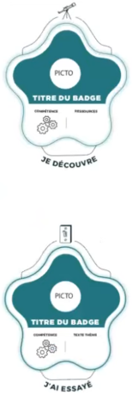
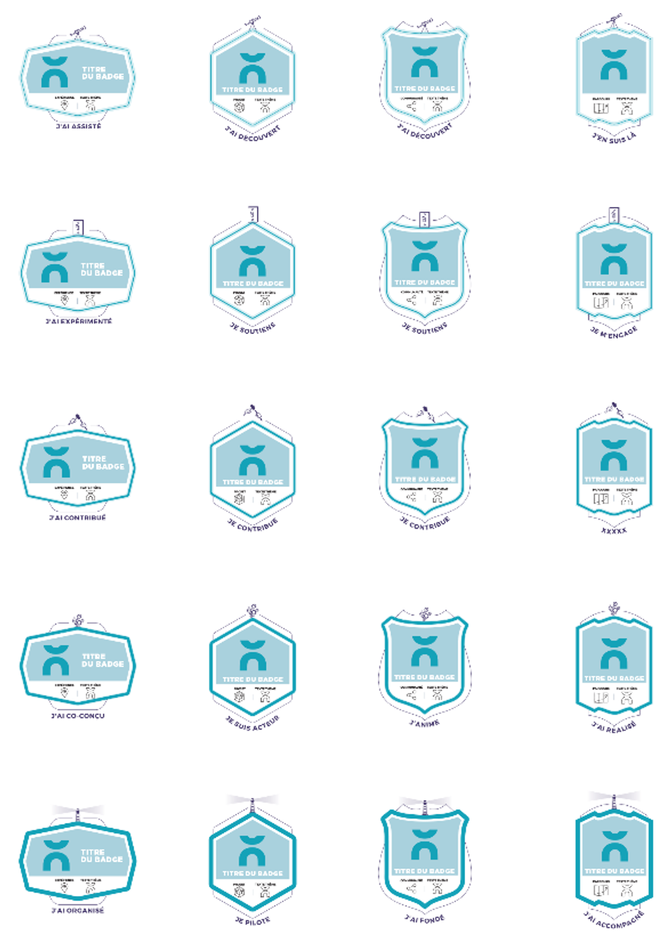
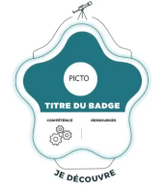
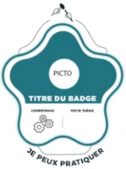
Normandy Activation Matrix
SAVOIRS ET COMPÉTENCES
ENGAGEMENT ET PARTICIPATION
KNOWLEDGE AND SKILLS
ENGAGEMENT AND PARTICIPATION
SAVOIR
SAVOIR FAIRE
SAVOIR ÊTRE
COMPÉTENCES
COMPÉTENCES
PROJET PROGRAMME
GROUPE COMMUNAUTÈ
PARCOURS
KNOWLEDGE
SKILL, KNOWHOW
ATTITUDES &
BEHAVIOURS
COMPETENCY
EXPERIENCE
PROJECTS & ACHIEVEMENTS
GROUP & COMMUNITY
PERSONAL
PATHWAYS
DISCOVERY,
DECLARATION
DISCOVERY,
DECLARATION
LEVEL 1
LEVEL 1
CLASSE 1
CLASSE 1
I DISCOVERED
I EXPLORED
I DISCOVERED
I EXPLORED
I DISCOVERED
I EXPLORED
I AM DISCOVERING
I AM EXPLORING
I WATCHED
I DISCOVERED
I DISCOVERED
I CHOSE
I CAME
PARTICIPATION,
SUPPORT
PARTICIPATION,
SUPPORT
LEVEL 2
LEVEL 2
CLASSE 2
CLASSE 2
I’M LEARNING
I TRIED IT
I TRIED IT
I DID IT
I PARTICIPATED
I SUPPORT
I AM A SUPPORTER
I LIKE
I SUPPORT
I STARTED
ACTIVE CONTRIBUTION
ACTIVE CONTRIBUTION
LEVEL 3
ACTIVATION
LEVEL 3
CLASSE 3
I’M PRETTY GOOD
I CAN DO IT
I AM
I CAN DO IT
I CONTRIBUTED
I CONTRIBUTE
I CONTRIBUTE
I AM WORKING ON
I WILL COMPLETE
CLASSE 3
CO-CREATION
CO-CREATION
LEVEL 4
LEVEL 4
CLASSE 4
I’M EXPERT
I CAN MAKE
I MODEL
I SHOW HOW
I DO IT
I CO-CREATED
I ACT
I DO
I LEAD
I COMPLETED
CLASSE 4
LEADERSHIP
LEADERSHIP
LEVEL 5
LEVEL 5
CLASSE 5
I CAN MENTOR
I CAN COACH
I CAN HELP
I CAN TEACH
I CAN MENTOR
I CAN COACH
I CAN HELP
I CAN TEACH
I CAN MENTOR
I CAN COACH
I CAN HELP
I CAN TEACH
I CAN MENTOR
I CAN COACH
I CAN HELP
I CAN TEACH
I ORGANISED
I PRODUCED
I DEVELOPED
I PILOT
I MAKE
I COACH OTHERS
I FOUNDED
I COACH OTHERS
CLASSE 5
CRÉDITS : CASUS BELLI, LE DÔME CC-BY_SA
TRANSLATION: learningagents.ca
https://www.echosciences-normandie.fr/communautes/le-dome/articles/badge
https://www.echosciences-normandie.fr/articles/des-badges-au-dome-saison-2
https://www.echosciences-normandie.fr/communautes/le-dome/articles/3-ans-pour-developper-des-usages-des-open-badges

Slide 6
Plane of Recognition… examples
Inclusion
(Community-centred)
Empowerment
Event
Speaker
Non-Formal
Badges
as goals
Partner
Organization
Event
Participant
Annual
Awards
Community
Expert
Participation
Badge
Flexible Recognition
Special
Awards
Completion
Badge
Organization
Appreciation
(CSR, Funder)
Self-assertion
Badges
Learning
Organization
Volunteer
Appreciation
Recognition
Affiliation
Peer-issued
Badges
Demonstration
Traditional
Non-Traditional
(Past / Static)
Membership
(Future / Dynamic)
Training
Certificate
Mentor
Mentee
Certification
Badge
Pathways
Micro-credentials
Common interest
badges
Competency
Badges
Conformance
Enablement
Formal
(Institution-centred)
Adapted from Serge Ravet (ORA)

Slide 7
Plane of Recognition… where do your badges fit?
Inclusion
(Community-centred)
Empowerment
Non-Formal
Recognition
Traditional
Non-Traditional
(Past / Static)
(Future / Dynamic)
Conformance
Enablement
Formal
(Institution-centred)
Adapted from Serge Ravet (ORA)

Slide 8
Copy and remix as needed. Be creative!
Pathways View
TABLE ____
Cluster
Sequence
2023-09-27
“Step”
Badge Name
“Step”
Badge Name
Milestone
Badge Name
Milestone
Badge Name
“Step”
Badge Name
“Step”
Badge Name
“Step”
Badge Name
“Step”
Badge Name
“Step”
Badge Name
“Step”
Badge Name
Some step options
Sequential Program
Course
Milestone
Badge Name
Nested Milestones
“Step”
Badge Name
“Step”
Badge Name
“Step”
Badge Name
“Step”
Badge Name
Assignment,
Deliverable
Application
of learning
Super
Milestone
Badge Name
Independent
Assessment
Electives (e.g. 2 of 4)
“Step”
Badge Name
“Step”
Badge Name
Placement,
Internship
Achievement
Milestone
Badge Name
“Step”
Badge Name
“Step”
Badge Name
Certification

