Slide 1
Accountability & Follow-through (Part 1)
Judy Chang
Effective Leadership
Oct 28, 2020

Slide 2
We all struggle with motivation and execution from time to time.
By the end of the class, you will be able to:
Contrast Intrinsic vs. Extrinsic motivators
Identify your own intrinsic motivators
Write a goal for accomplishing the task
Next class
Implement tools for planning and execution
Reflect on how you did
Review & Adjust
Create your own growth Mindset

Slide 3
Accountability and getting things done
Motivate
Move to intrinsic motivations
Plan
Remember to write out your specific plan and keep it visible
Reflect
Review & Adjust
Adjust if you need to
Execute
Eliminate temptations
Reward and consequences

Slide 4
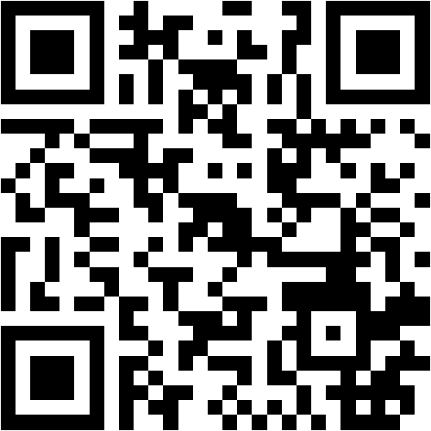
Poll: Think of one thing that you’ve been procrastinating to complete. What is preventing you from getting it done?
Go to Menti.com
Code 28 36 66 6

Slide 5
Motivate

Slide 6
What is motivation?
Motivation is the desire to act in service of a goal
Research shows that people can influence their own levels of motivation and self-control

Slide 7
Motivation – the fuel to get you started
Both Intrinsic and Extrinsic can be powerful motivators
INTRINSIC motivators tend to be value based and can be more sustaining than EXTRINSIC
EXTRINSIC motivators can be useful to motivate NEW behaviours that you want to kickstart
Extrinsic
Mastery
Connection
Enjoyment
Achievement
Self-worth
Purpose
Freedom
Money
Praise
Competition
Fear of punishment
Power/Status
Social Acceptance
Intrinsic
Playing sports to win an award
Studying to get a good grade
Cleaning your room so you don’t get yelled at
Playing sports for the enjoyment
Studying because you want to learn more
Cleaning your room to have a clean space

Slide 8
Think of one task that you keep procrastinating
1. Think of something that you’ve been procrastinating to complete.
2. What intrinsic or extrinsic motivators can I use to get me going?
Money
Praise/Feedback
Competition
Fear of punishment
Power/Status
Social Acceptance
Mastery
Connection
Enjoyment
Achievement
Self-worth
Purpose
Freedom
I’ve been avoiding completing my website because I don’t really enjoy doing it. Despite a lot of hard work, I don’t think I am doing a good job. I’m afraid people will laugh.

Slide 9
Identify intrinsic Motivations
Think of one task/to do that you’ve been procrastinating
List some intrinsic and extrinsic motivations that are important to you to motivate yourself.
Example
One task that I’ve been avoiding to complete.
Finishing my website.
2. The Extrinsic motivators that can help me get going.
Feedback/Praise.
3. The intrinsic motivators that can help you view it different?
Purpose
Learning, Growth
Connect
Use the Discussion Board for Week 4 Link to share your task and 3 potential motivators.
https://learn.senecacollege.ca/ultra/courses/_624807_1/cl/outline

Slide 10

Quick check 1 Is this student motivated by intrinsic or extrinsic motivators?
I really want to get a good grade on this assignment because I want to go into this field. It will also make my family really proud of me

Slide 11
Plan

Slide 12
Forming a Plan
Once you identify a powerful motivation, the plan is easy.
Determine how long it will take for you to complete the goal.
Break the goal down into the steps and consider spreading out the steps over a period of time if it’s going to take more than 1 – 2 hours.
Schedule time complete the task in your system of choice (planner, blackboard, calendar, post it notes … )
Write your plan with specifics

Slide 13
THE RESEARCH
In 2001, researchers in Great Britain began working with 248 people to build better exercise habits over the course of two weeks. The subjects were divided into three groups.
About 1/3 of Group 1 & 2 exercised at least once a week
What % of people do you think exercised at least once a week In Group 3?
Group 1
(control group)
track how often they exercised
Group 2
(motivation group)
track their workouts and info on benefits of exercise.
Group 3
(Intent Group)
Same as Group 2 and formulate a plan for when and where they would exercise over the following week.
Source: Sarah Milne, Sheina Orbell, and Paschal Sheeran, “Combining Motivational and Volitional Interventions to Promote Exercise Participation: Protection Motivation Theory and Implementation Intentions,” British Journal of Health Psychology 7 (May 2002): 163–184.

Slide 14

91%
of group 3 exercised at least once per week

Slide 15

The secret ingredient: WRITE IT DOWN
2x – 3x more likely higher chance of completion when you declare how you plan to implement
I will exercise for at least 30 minutes on [DATE] in [PLACE] at [TIME]
The intent needs to be Specific, Measurable, Actionable, Relevant and Timely

Slide 16
Create SMART goals
I will [BEHAVIOR] at [TIME] in [LOCATION].
S = Specific behaviour
M = Measurable actions
A = Actionable (eg. You can do it)
R = Relevant to your purpose
T = Time-bound (there is a time limit)

Slide 17

Final Check What are you taking away today as the most important things? https://bit.ly/3e4gYJe

Slide 18
Putting it all together
Motivate
Move to intrinsic motivations
Plan
Remember to write out your specific plan and keep it visible
Accountability
Review & Adjust
Adjust if you need to
Execute
Eliminate temptations
Reward your accomplishments

Slide 19
Questions?

