Slide 1
SPSS Basics
By: Babak Saremi

Slide 2
The Outcomes of this Lesson
What is SPSS?
SPSS history, versions, and price
How SPSS is different from R, SAS, and Python?
General steps of handling a dataset
Importing data into SPSS/PSPP

Slide 3
Objectives of this Lesson
To get familiar with SPSS
To be able to import data and define variables

Slide 4
What is SPSS?
SPSS stands for Statistical Package for Social Sciences
SPSS is super easy software for analyzing data and running statistical tests
The software was released in its first version in 1968
Long produced by SPSS Inc., it was acquired by IBM in 2009
The latest version is SPSS V28
License price is 99$ (USD) per month per user
PSPP is a basic free version of SPSS (find it on www.gnu.org)

Slide 5
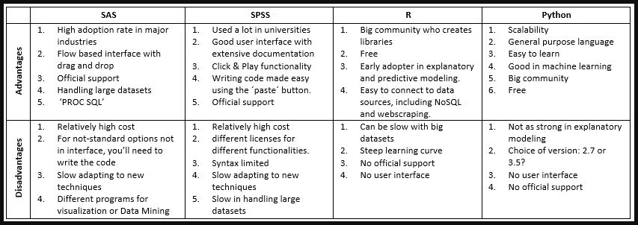
Python, R, SAS, or SPSS ?
Notes:
PROC SQL is a powerful Base SAS7 Procedure that combines the functionality of DATA and PROC steps into a single step
A NoSQL database provides a mechanism for storage and retrieval of data that is modeled in means other than the tabular relations used in relational databases

Slide 6
General Steps to Do with Your Dataset !
1. Import data from Excel to SPSS
2. Check and define variables on Variable View tab
3. Clean and prepare your data (check out missing data and outliers)
4. Analyze data and report the results

Slide 7
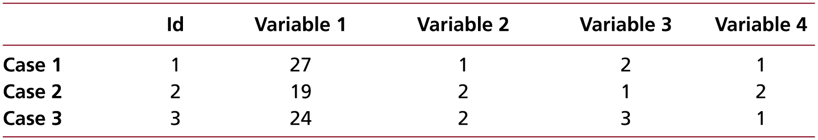
A Simple Data Matrix

Slide 8
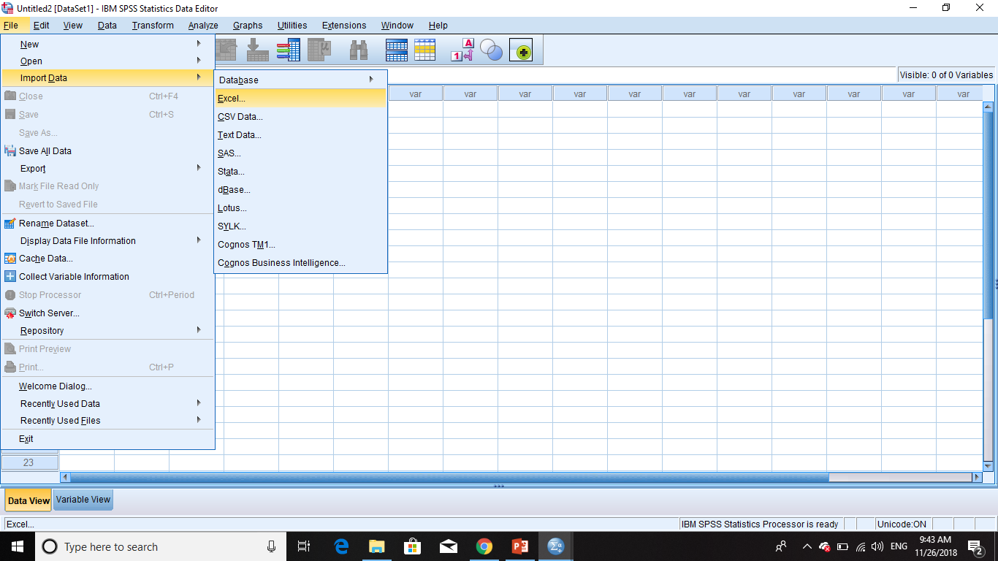
Importing Data from MS Excel

Slide 9
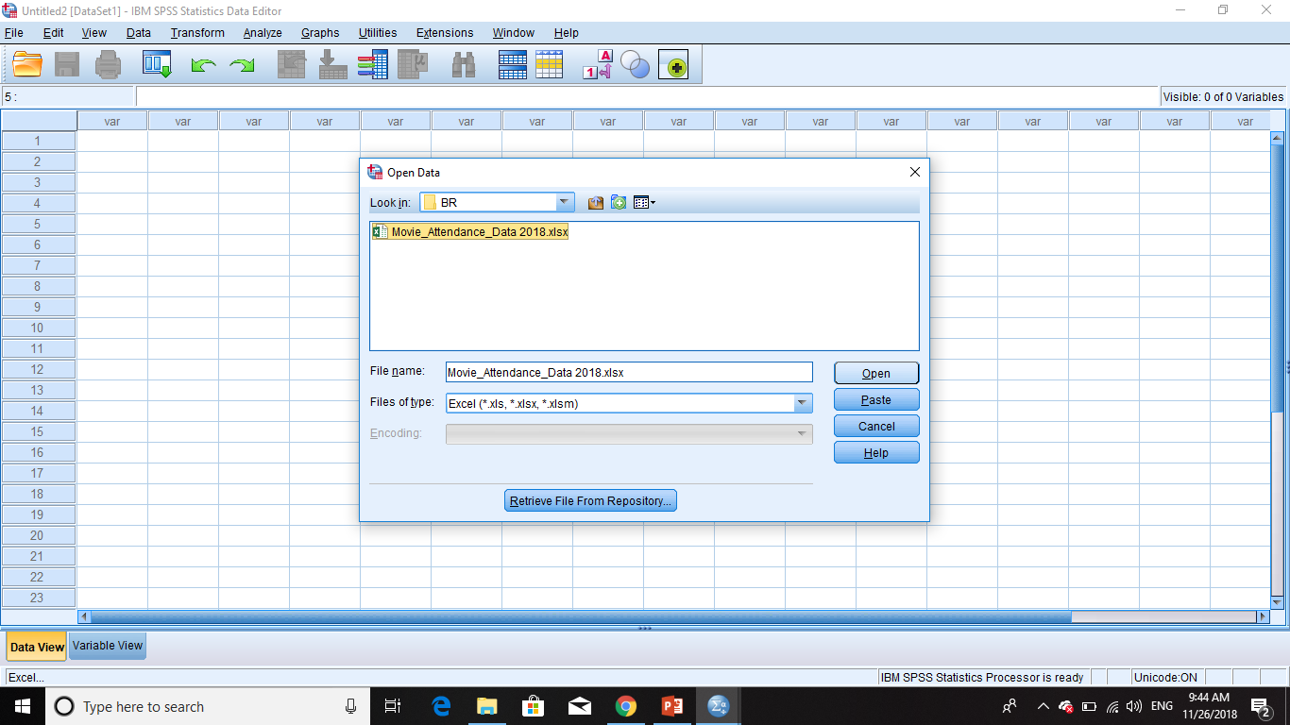
Importing Data from MS Excel …

Slide 10
Practice !
Download free SPSS version (PSPP) from this link and install it:
https://www.gnu.org/software/pspp/get.html
Download the dataset from link bellow:
Movies Questionnaire Dataset.xls
Import data from your dataset to PSPP
Define Variables

Slide 11
Review of Contents
SPSS and PSPP
How SPSS differs from other statistical software?
How to import data from excel into SPSS/PSPP
How to set variables

Slide 12
Resources
Data Entry: https://www.youtube.com/watch?v=MoKDcPpRa_0
To download PSPP: https://www.gnu.org/software/pspp/get.html
Good Luck with your exercise

