Slide 1


Recognition Canvas Toolkit
Design Challenge Format
Adapted and extended by Learning Agents from the Badge Canvas, a longtime useful brainstorming tool in the Open Badges community. Published here as a PowerPoint workbook.
Copy and adapt as needed to plan your overall recognition system and to sketch in badge content. This tool can be used solo, or as a group collaboration tool, digitally or in hard copy (up to 22”x34”).
Licensed Creative Commons with Attribution (CC BY). Last updated 2026-03-09

Slide 2

Design Challenge Examples – adaptable… edit freely!
Challenge your participants with human-centred use cases to spark creative thinking about recognition…
Challenge #__
“Work Ready” badges for Youth
Develop a badge system that develops and recognizes a cluster of skills that are relevant to workforce entry in a target sector, with a strong emphasis on transversal skills.
Focus on youth and transition from education (or training) to the workplace.
Seek authentic assessment opportunities that go beyond course completion to include focused application and real-life experience from diverse contexts.
Challenge #__
Workplace Recognition & Upskilling
Design a badge/micro-credential system that helps organisations develop the policies, practices (and skills!) needed for an effective internal “recognition function” to encourage, evaluate and recognize skills, making workforce upskilling and organizational productivity improvement more agile and responsive.
It should be trustable, but also pragmatic and “fit for purpose.”
Challenge #__
“Skills” badges for Organizations
Design a badge system that SMEs and other “learning organizations” can use to develop and be recognised for standards, practices and achievements. This can be at various levels of maturity: awareness, commitment, development, performance, leadership…
How is this use case the same as individual skills?
How is it different?
Challenge #__
“Reskilling” micro-credentials for Adults
Design a credentialing system for mid-career transition that includes durable, transferable skills and highly specialized skills specific to a sector. “Adults” can be specifically defined as Newcomers, Indigenous, NEETs, etc.
Think beyond training to include more appreciative strategies such as Recognition of Prior (Experiential) Learning, applied & work-based learning & “informal apprenticeships” to make your program more engaging, accessible and agile.
Challenge #__
Recognition of Semi-formal Programs
Design micro-credentials to make a semi-formal program within an organization or sector body more portable and widely accepted for employability, sectoral mobility and/or transferability to educational or professional contexts.
Focus on a specific use case, e.g. how can a semi-formal program that’s “fit for purpose” in a workplace context be “pre-evaluated” for transition into PSE or a profession?
What are some key elements to consider?
Challenge #__
[Your Use Case Here]
Don’t see anything that sparks your creativity?
Then use that creativity to imagine your own challenge!
Design a badge system that helps….
Learning Agents 2026-02-21

Slide 3



Recognition Design Canvas | Preliminary Notes View (OPTIONAL)
Design Challenge #__
[Design Challenge Name]
[PASTE OR CREATE YOUR CHALLENGE HERE]
Solution Notes
Optional space for you to brainstorm and make notes on how will you meet the challenge…
Learning Agents 2026-02-21

Slide 4

Recognition Design Canvas | Core Canvas View
Design Challenge #__
BACKGROUND context
REQUIRED info
OPTIONAL info
Issuer Perspective
Who is issuing the badge? How are they qualified? How will this help them?
Badge image
Tags Optional
1-5 words to help classify the badge when scanned quickly.
Required
A simple graphic image in the white space
GRAPHIC
Earner/Recipient Perspective
What is the target group? How do they learn about it? What will this cost them? How will this help them?
Expiration Optional
Should it expire? Does it require renewal? Express in months.
BADGE NAME
Required
Put the badge name on the label
Viewer/Consumer Perspective
Who will evaluate this badge and its earner? Are they aware and receptive? How will this help them?
Description Required
Concise, outcomes based: what has the badge earner achieved?
Alignment Optional
Can you build value by aligning to a standard or a skills framework?
Type of recognition?
One or more of (bold/circle which apply and/or delete others):
Assessment-based course (rigorous summative assessment)
Completion-based course (e.g., self-paced elearning; formative or no assessment)
Participation-based event (e.g., workshop, webinar; formative or no assessment)
Certification of a specific skill or broader competency, with performance criteria
Evaluated Evidence or Demonstration
Application, Performance, Experience, Placement
Membership, affiliation
Flexible recognition (often informal): (e.g., achievements, special awards, projects, makerspaces, events, volunteers, mentors, experts)
Peer recognition/referral, self assertion of achievements+ evidence
Other (describe)
Criteria Required
How does someone earn this badge? What learning activities, behaviours? How much effort? What assessment? What evidence? Be as clear and transparent as possible.
Endorsement Optional
Would a third party endorse this badge? Why? Formal or informal?
Multiple languages
Should the badge content be multilingual? What is the default language?
Learning Agents via DigitalMe Open Badge Design Canvas, Jisc Open Badges Design Toolkit, Serge Ravet's Canevas délaboration and the Badge Alliance Badge System Design Template 2026-02-21

Slide 5
Recognition Design Canvas | Analysis View
Design Challenge #__
Design Challenge #...
PASTE OR CREATE YOUR CHALLENGE HERE
THEN ANALYZE THE STRATEGY OF YOUR SOLUTION BELOW...
Analysis
Use any or all of the topics below to analyze your solution. Add your own topics as needed.
Portable recognition?
How does your solution authentically support recognition across contexts and communities?
Drivers?
Why will it work? Why does it HAVE to happen?
Players?
Who should be on the team? Within your organization? From other organizations?
Benefits?
What are the benefits? What problems will this address? How will it accomplish it?
Collaboration and co-creation or separate solitudes?
How will you work with the other players?
Risk Analysis
Why won’t it work? What barriers exist? How can you overcome these?
Agility, scalability, sustainability?
How will you grow and sustain your solution?
Additional notes
Learning Agents 2026-02-21

Slide 6





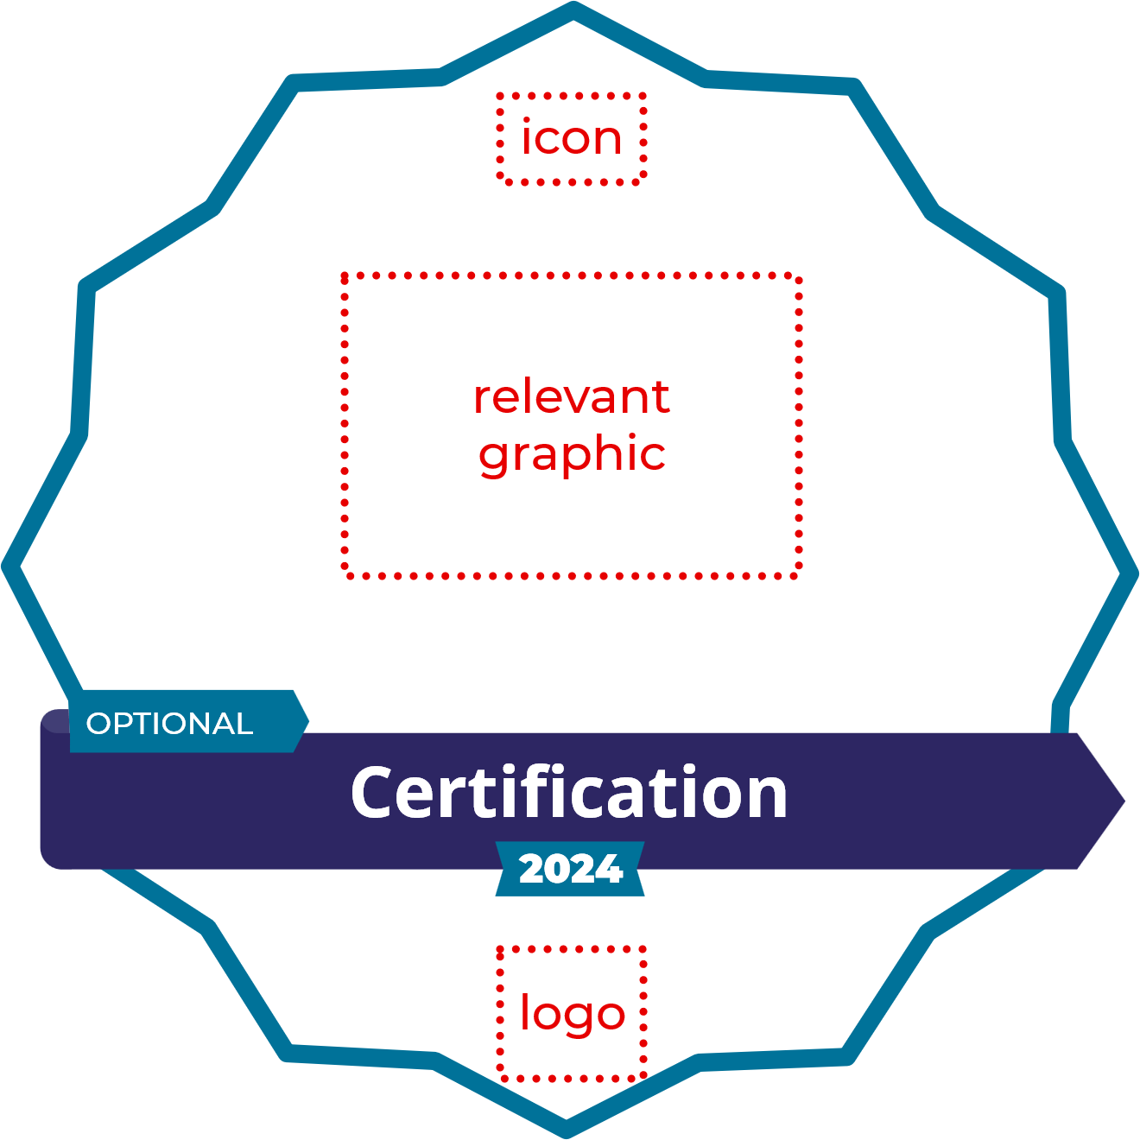
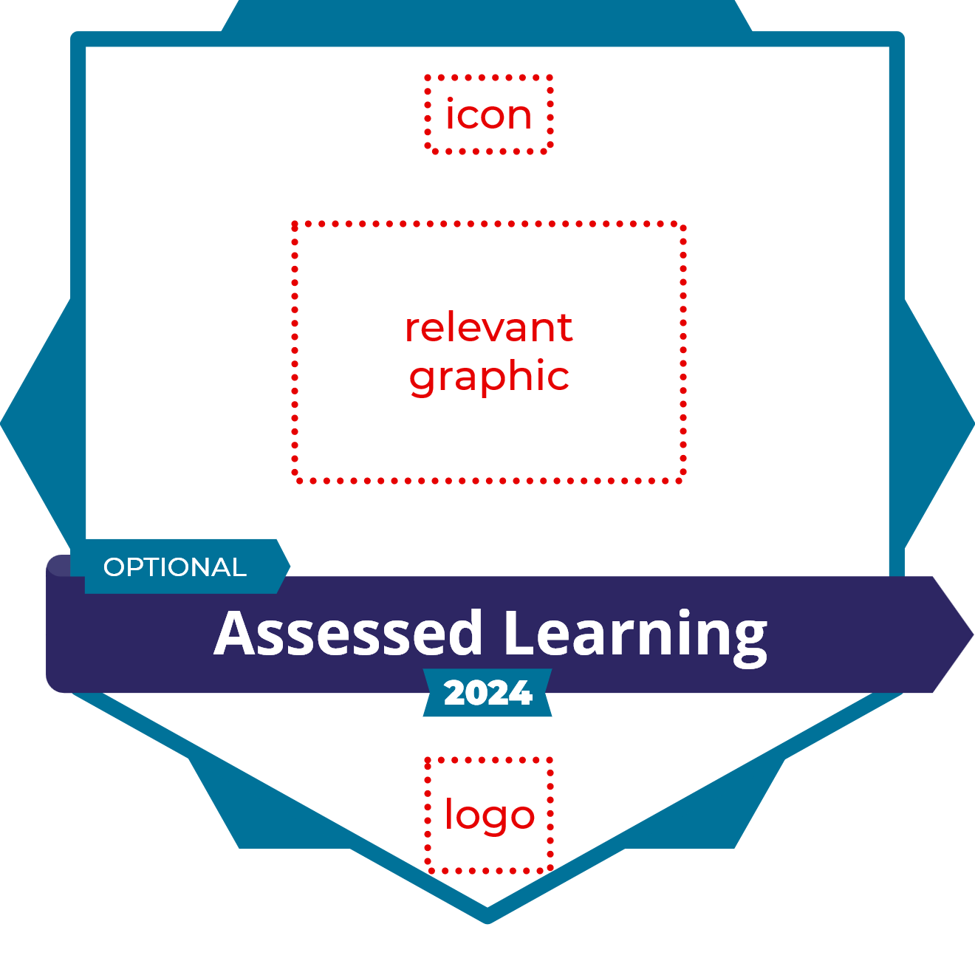
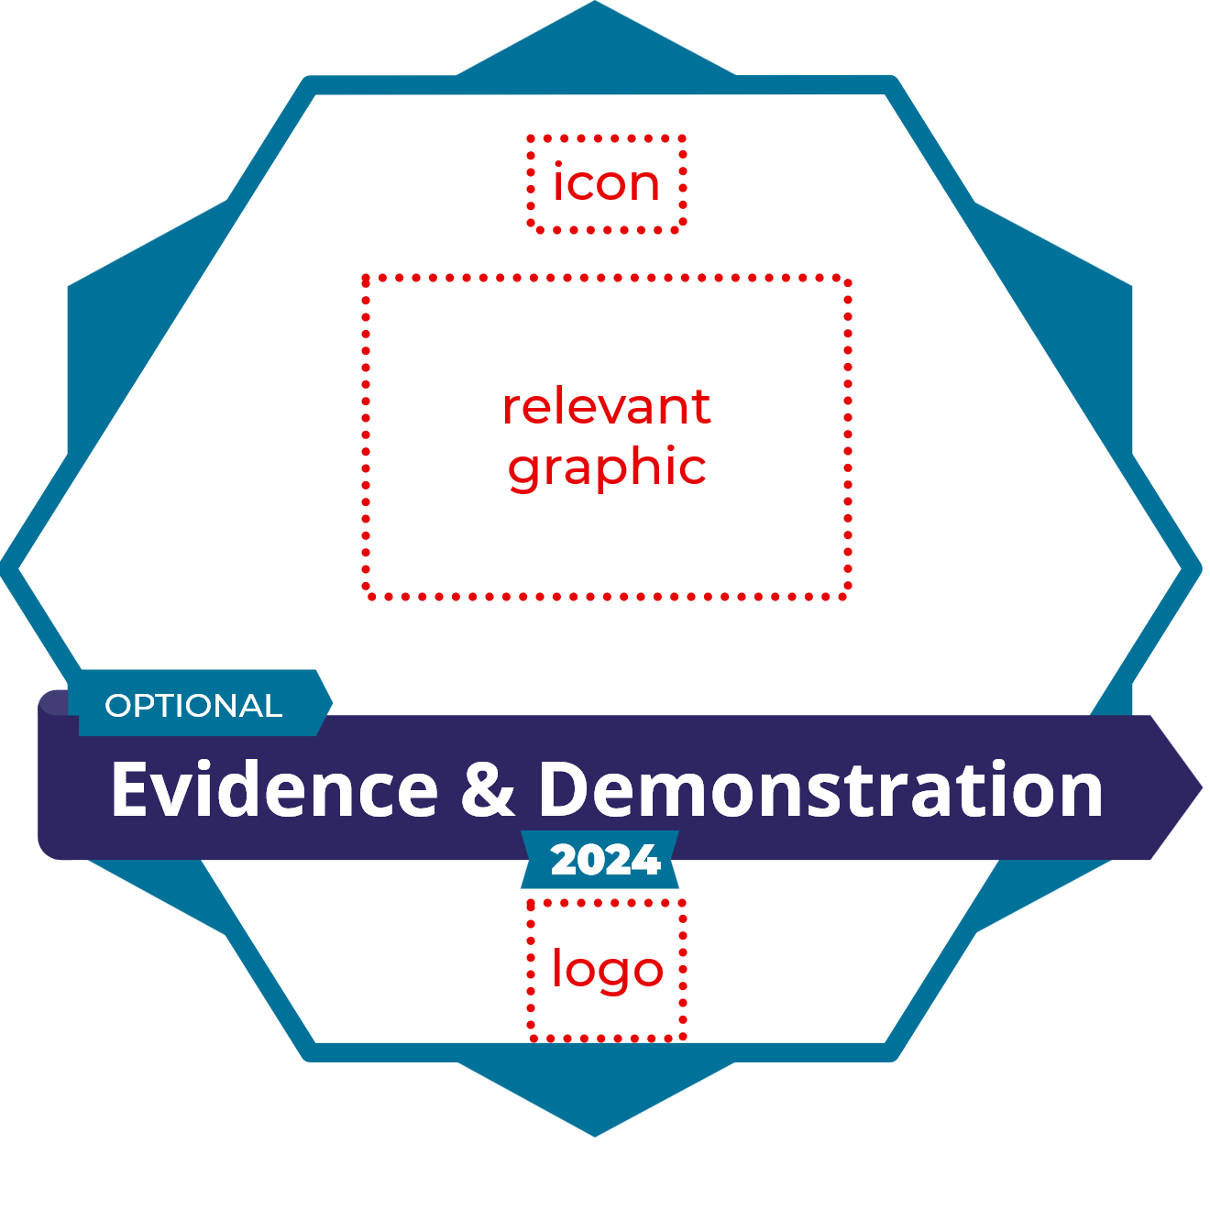
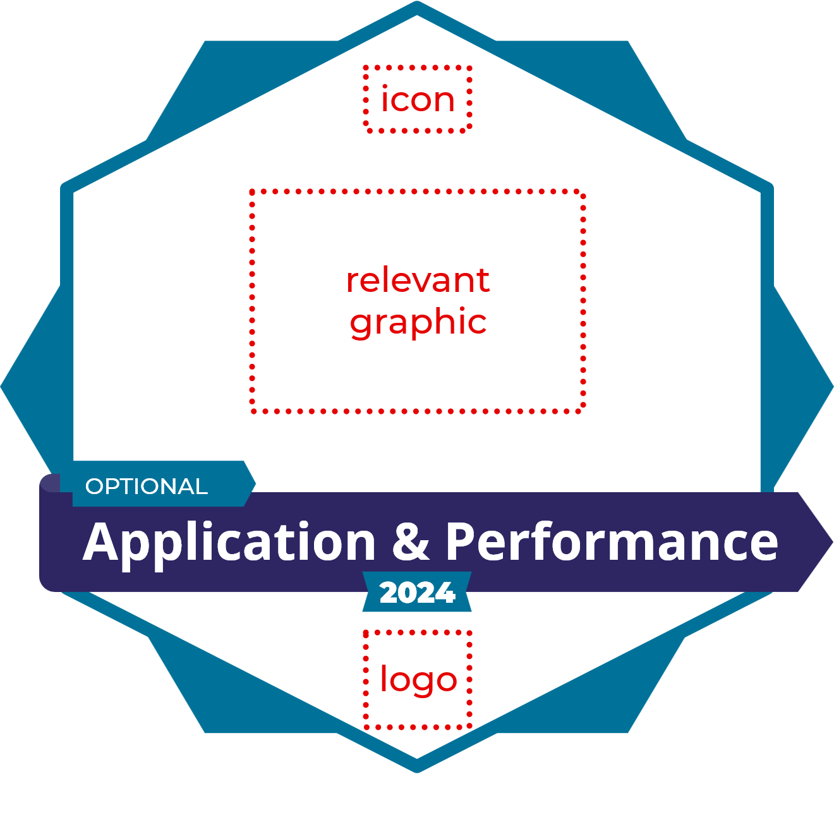
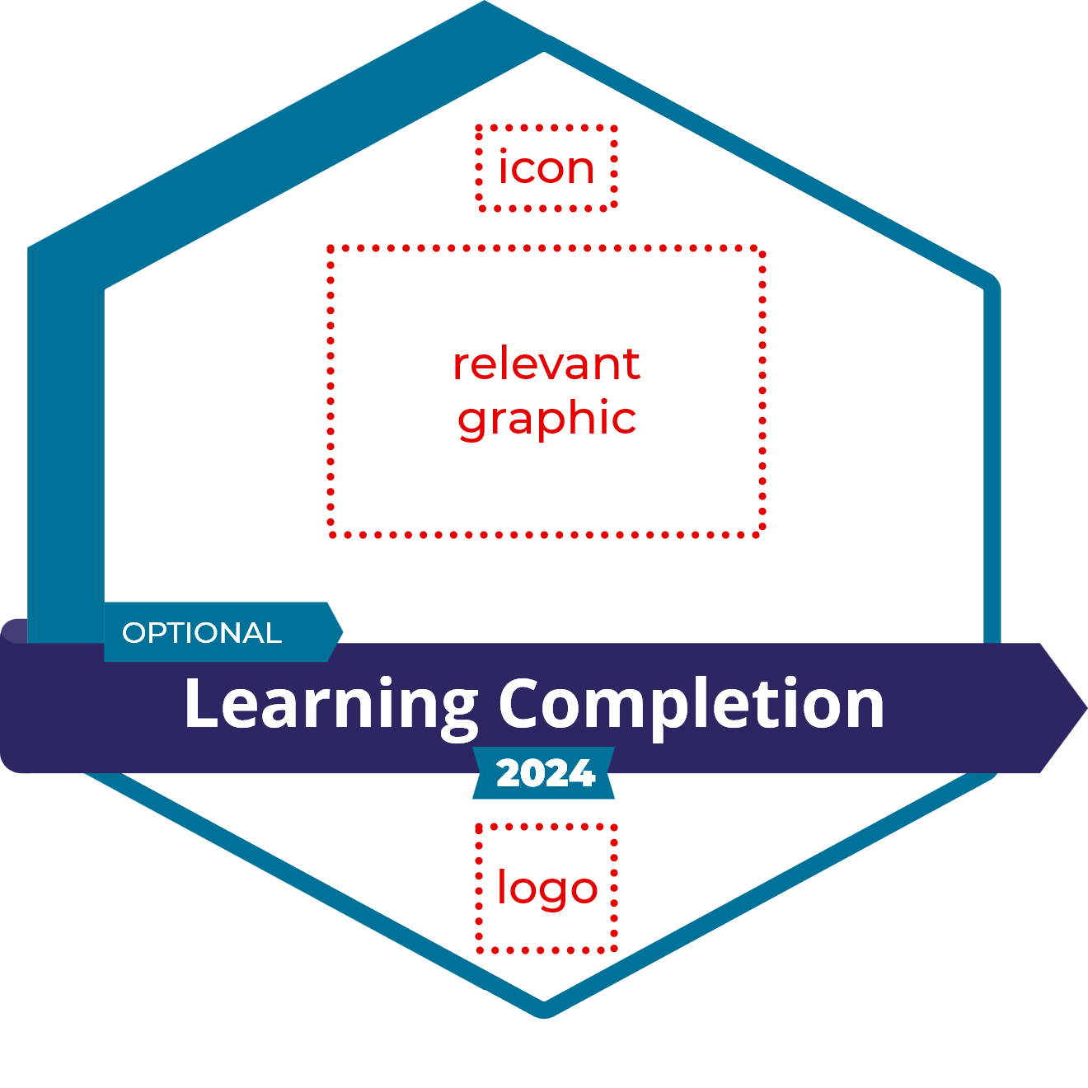
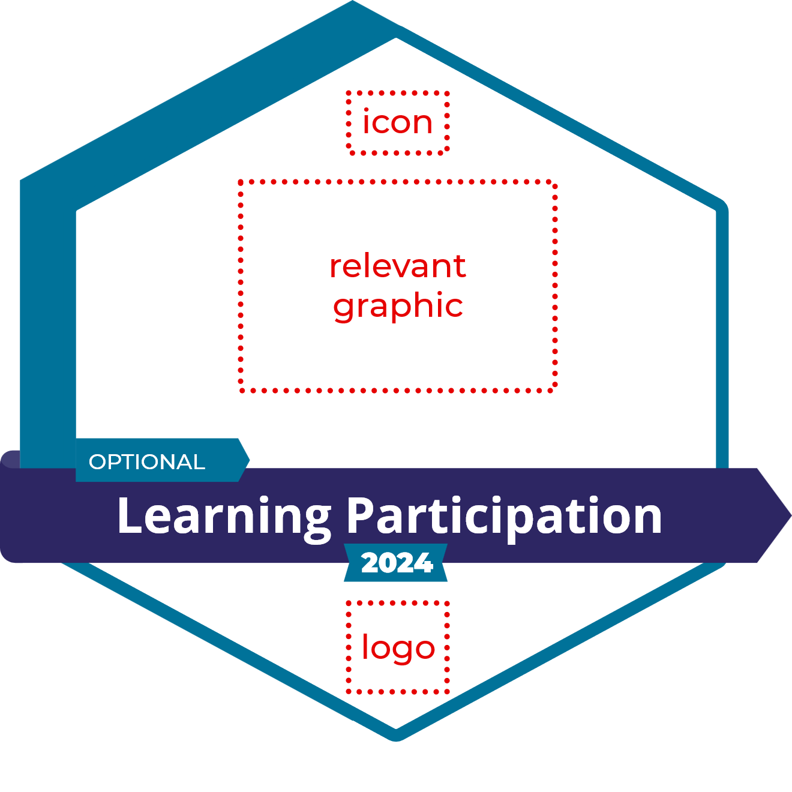
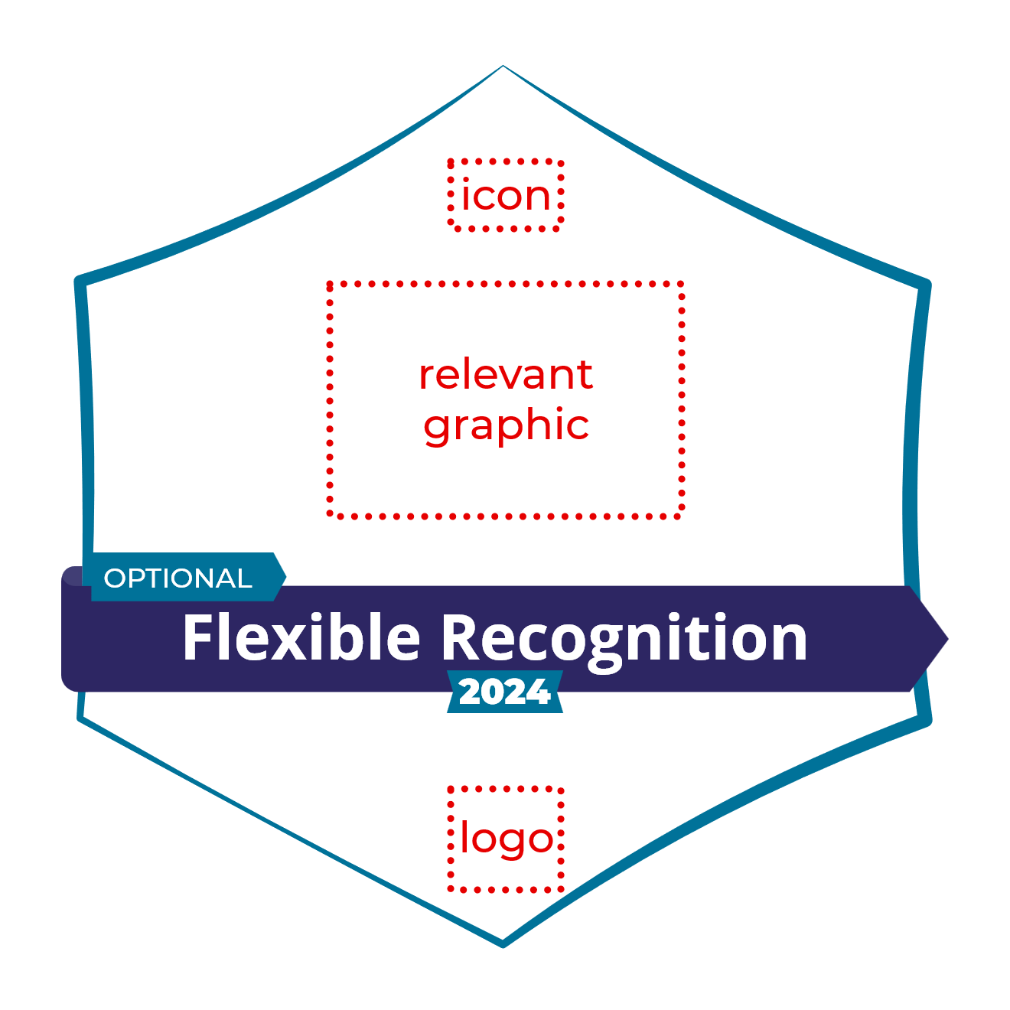
Learning Agents Flexible Recognition Framework [REFERENCE]
Master Certificate, “macro-credential” Prescribed certification program
Multi-LER Verifiable Presentation Comprehensive Learning Record (CLR)
STACKING
Recommended pathway
Retrospective journey
Showcase collection
Curated portfolio
Milestone
FORMAL Summative, Auditable, Standardized
NON- / SEMI-FORMAL, INFORMAL Formative, Appreciative, Personalized
more formal (“micro-credentials”)
ASSESSMENT
less formal – no summative assessment
Institutional Established
ASSURANCE
Assessed or Not Assessed
SOCIALIZATION
Community Based Emergent
BADGE
CATEGORIES
Certification
in a role
Assessed Learning
Evidence & Demonstration
Application & Performance
Organized Learning NOT Assessed
Flexible Recognition
EXAMPLE IMAGES
BADGE THEMES
Competent,
Performance Assured
Delivered, Verified
Documented,
Surfaced
Activated,
Sustained
Planned,
Structured
Planned
or ad hoc
EXAMPLE BADGE TYPES
Professional
Certification
Assessed Program Certificate
(“meso-credential”)
Project + Evidence
Application of Learning
Workshop
Participant
Worker
Appreciation
Regulated License
Assessed Course Certificate
Workshop
+ Evidence
Work Placement,
Internship, WIL
Webinar Participant
Team/Group
Appreciation
Prescribed certification program Step
Live or Recorded Demonstration
Extended Observation, Probation
Event
Participant
Volunteer
Appreciation
Micro-credentials
- modular, assessed
- for credit/not for credit
IF assessed..
Targeted Evidence Package
Work History,
Experience
Event/Workshop/Webinar
Speaker Role
Community Award
RPL and credential articulation
Nonformal credential offerings (achievements) may be formally assessed as “pre-evaluated curriculum” by educators and professional bodies for articulation into micro-credentials, or toward qualifications and recorded (banked) as a repeatable form of credential articulation and transfer (CAT).
Nonformal or informal credential assertions issued to individuals may later be individually assessed (PLAR’d) for formal recognition. The achievements realized by these assertions may be also be recorded for future reference at this time, as appropriate.
Self-directed
Program + Evidence
Performance in a Role
Self-paced Course
Completion
Association
Membership, Awards
Study groups,
Action research
Outstanding
Performance
Completed Podcast/Resource
Peer Recognition
Work-Based Learning (WBL)
Mentor Role
Self-assertion
Mentee Role
Declaration,
Pledge, Target
Formal
Formal ←→ Semi-formal ←→ Informal
Non- / semi-formal
Informal
QUALITY ASSURED STRUCTURE
TRUSTED ISSUER
ACADEMIC/PROFESSIONAL VALUE
PORTABLE RECOGNITION
VARIABLE STRUCTURE VARIOUS ISSUERS
APPLIED VALUE
VARIABLE RECOGNITION
DELIBERATE STRUCTURE
ORGANIZATIONAL ISSUER
PRAGMATIC VALUE
CONTEXTUAL RECOGNITION
FLEXIBLE STRUCTURE
ANY ISSUER
SOCIAL VALUE
APPRECIATIVE RECOGNITION
Learning Agents As at 2026-01-17
Current version at learningagents.ca
Notes:
Learning Agents has developed a framework to help people get started with flexible recognition, based on our work over the years
→ First, the formal/non-formal spectrum,
split between the presence and absence of summative assessment…
that’s the “border of rigour”, so-called, for these generic types of badges,
Here are examples within the categories, apologies for any information overload, I AM trying to expand horizons here…
It’s important to note that some badges can span across categories and formality, as the arrows and the shaded area indicate
And they can be stacked in various ways in different contexts
We provide this framework as a guide for appropriate metadata for the different kinds of badges. It’s quite adaptable and it’s certainly not the only one out there, 1Edtech’s TrustEd framework is another example – No matter what your framework, it’s all about transparency: be clear about what you’re claiming, and then make sure you support your claim with appropriate metadata.
*****************
Based on our work, Learning Agents has developed a shareable framework to help organizations get started with flexible recognition:
→ First, the formal/non-formal spectrum,
split between the presence and absence of summative assessment… the “border of rigour”, so-called..
…for these high-level badge types, that run from formal to informal, providing assurance or maybe just awareness
Here’s some stacking, with different labels based on formality
Now let’s dive deeper, starting with formal certifications and certificates
Ideally, (not always) these are based on standards and guidelines that make their value clear But other types of recognition can also add value, for example:
Direct evidence and demonstrations of skill,
Authentic work experience and work-based learning, …both of which can be formally assessed or simply asserted, maybe with evidence..
Then we have organized learning that’s not really assessed, webinars and self-paced intro courses, for example…
.. And mentoring, usually organized
On the informal end, we have flexible recognition: appreciative, community-wide,
between peers, or even individually empowered by self-assertion
Of course, you can use the same concepts to recognize organizations, because lots of work requires lots of people
Here are some keywords to help flag themes across the framework…
The arrows indicate that these concepts and categories can morph and recombine into each other,
Such as self-directed learning that builds evidence through application and performance..
Or maybe an Event Speaker Self-assertion
Or even workplace projects that combine individual achievement with organizational improvement
Formal, non-formal informal – a rich tapestry of lifewide learning and recognition that goes way beyond pre-conceived courseware
Have your brains exploded? Let’s put them back together…

Slide 7
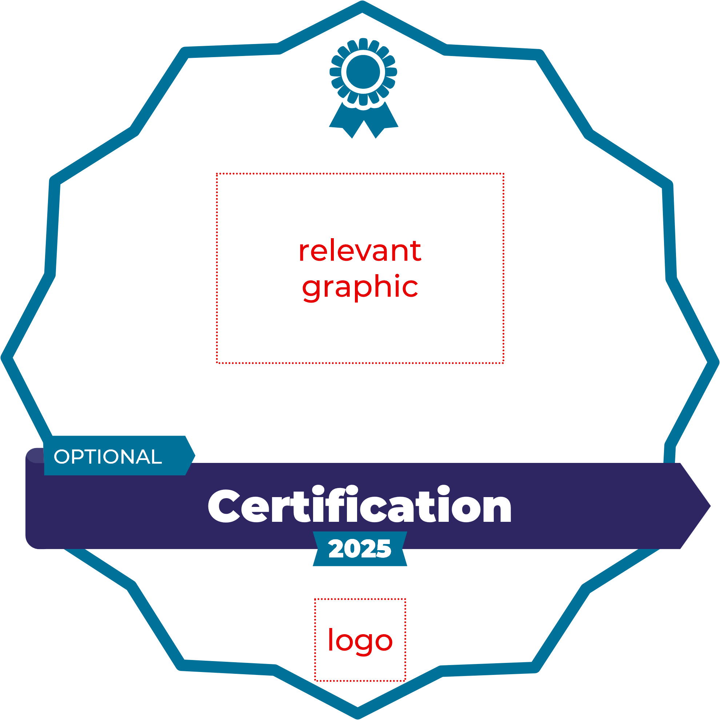
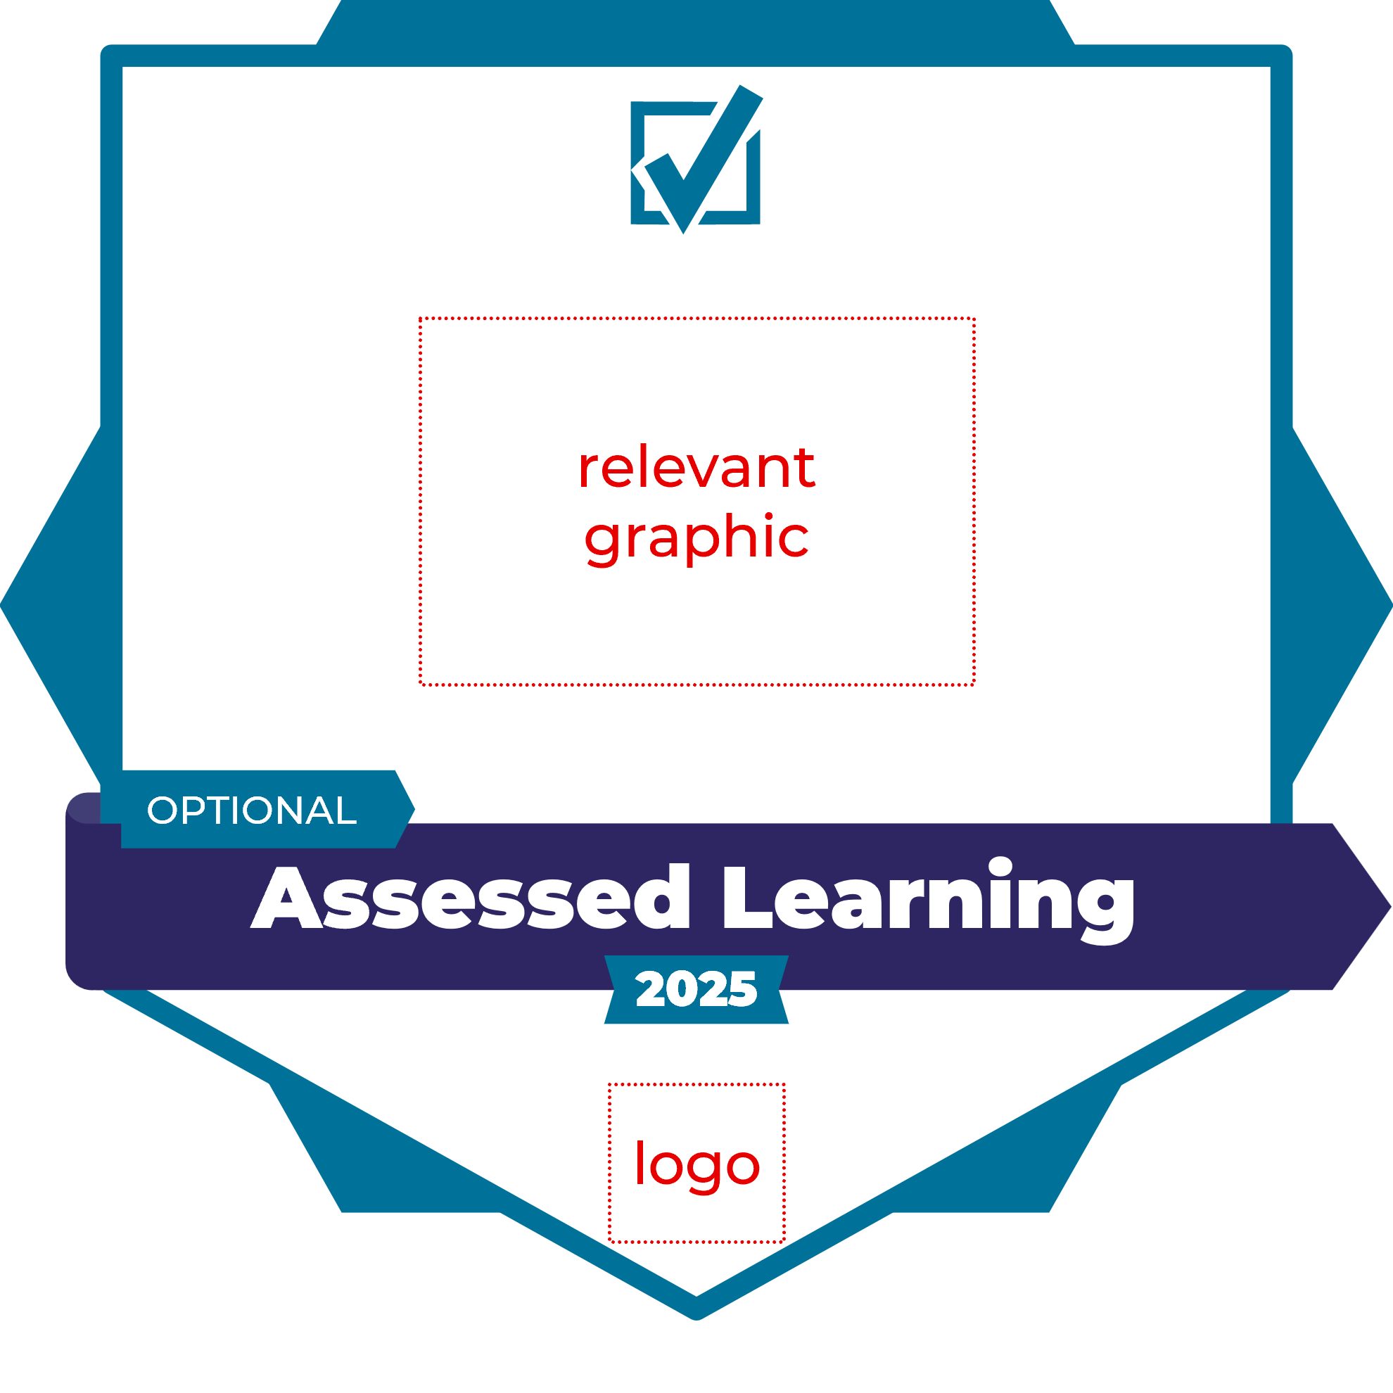
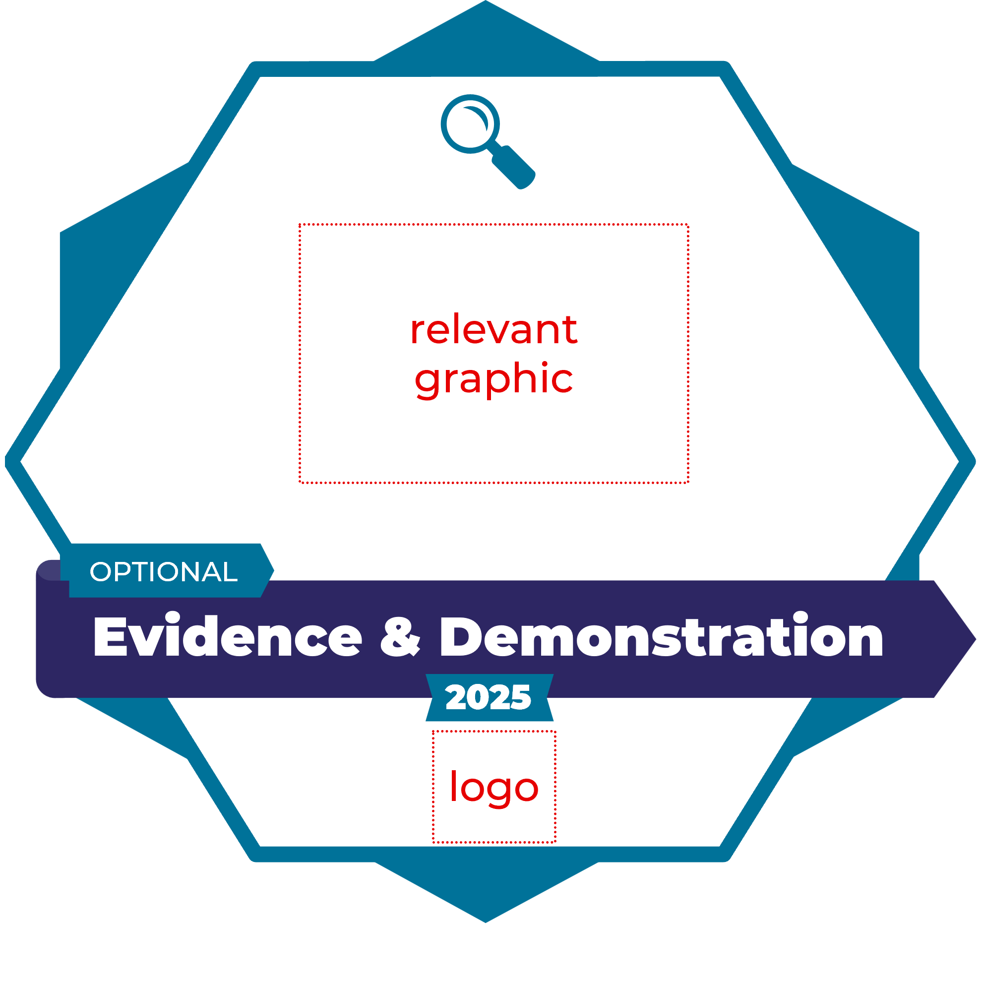
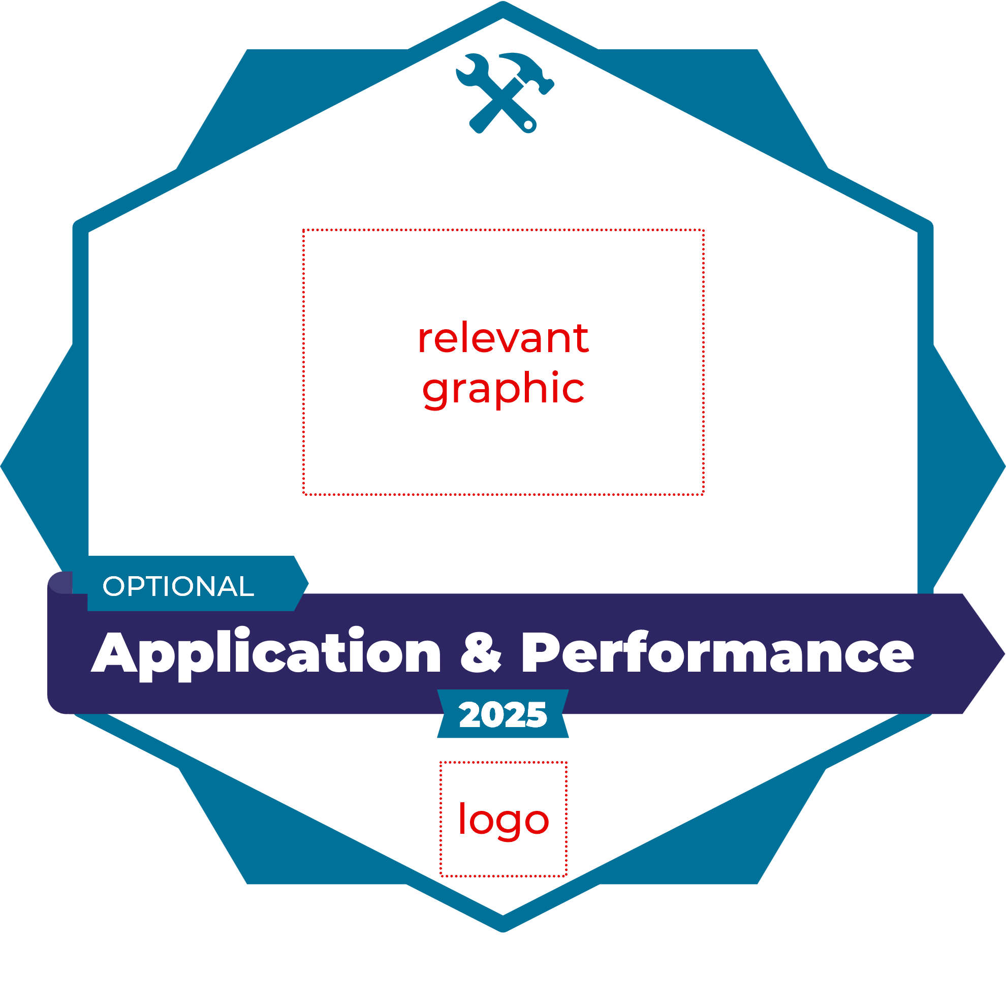
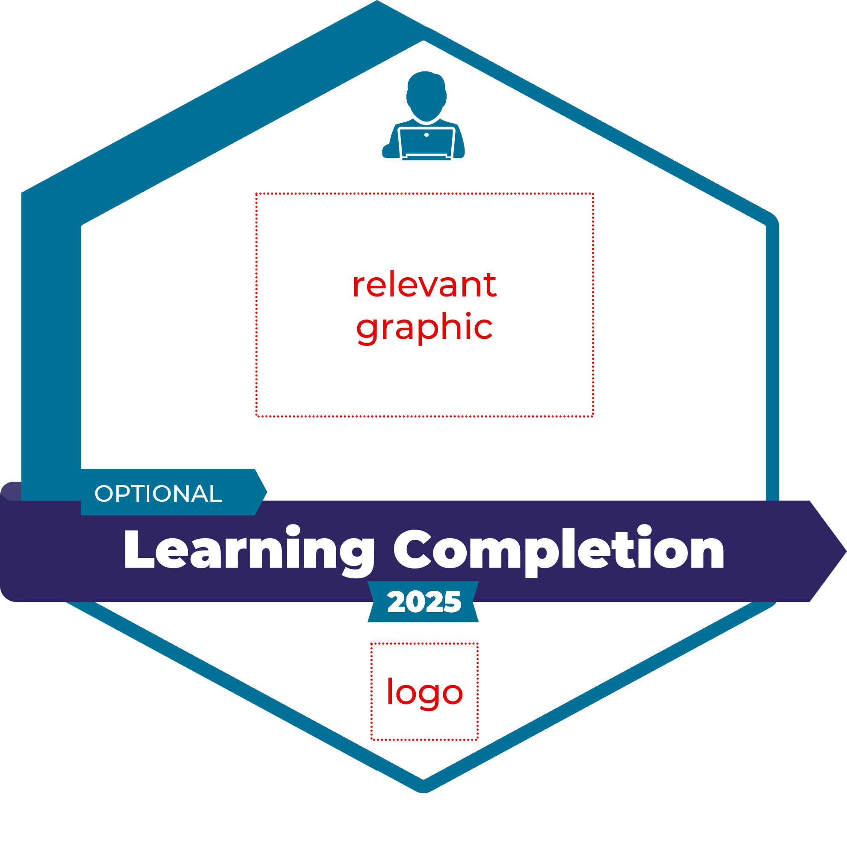
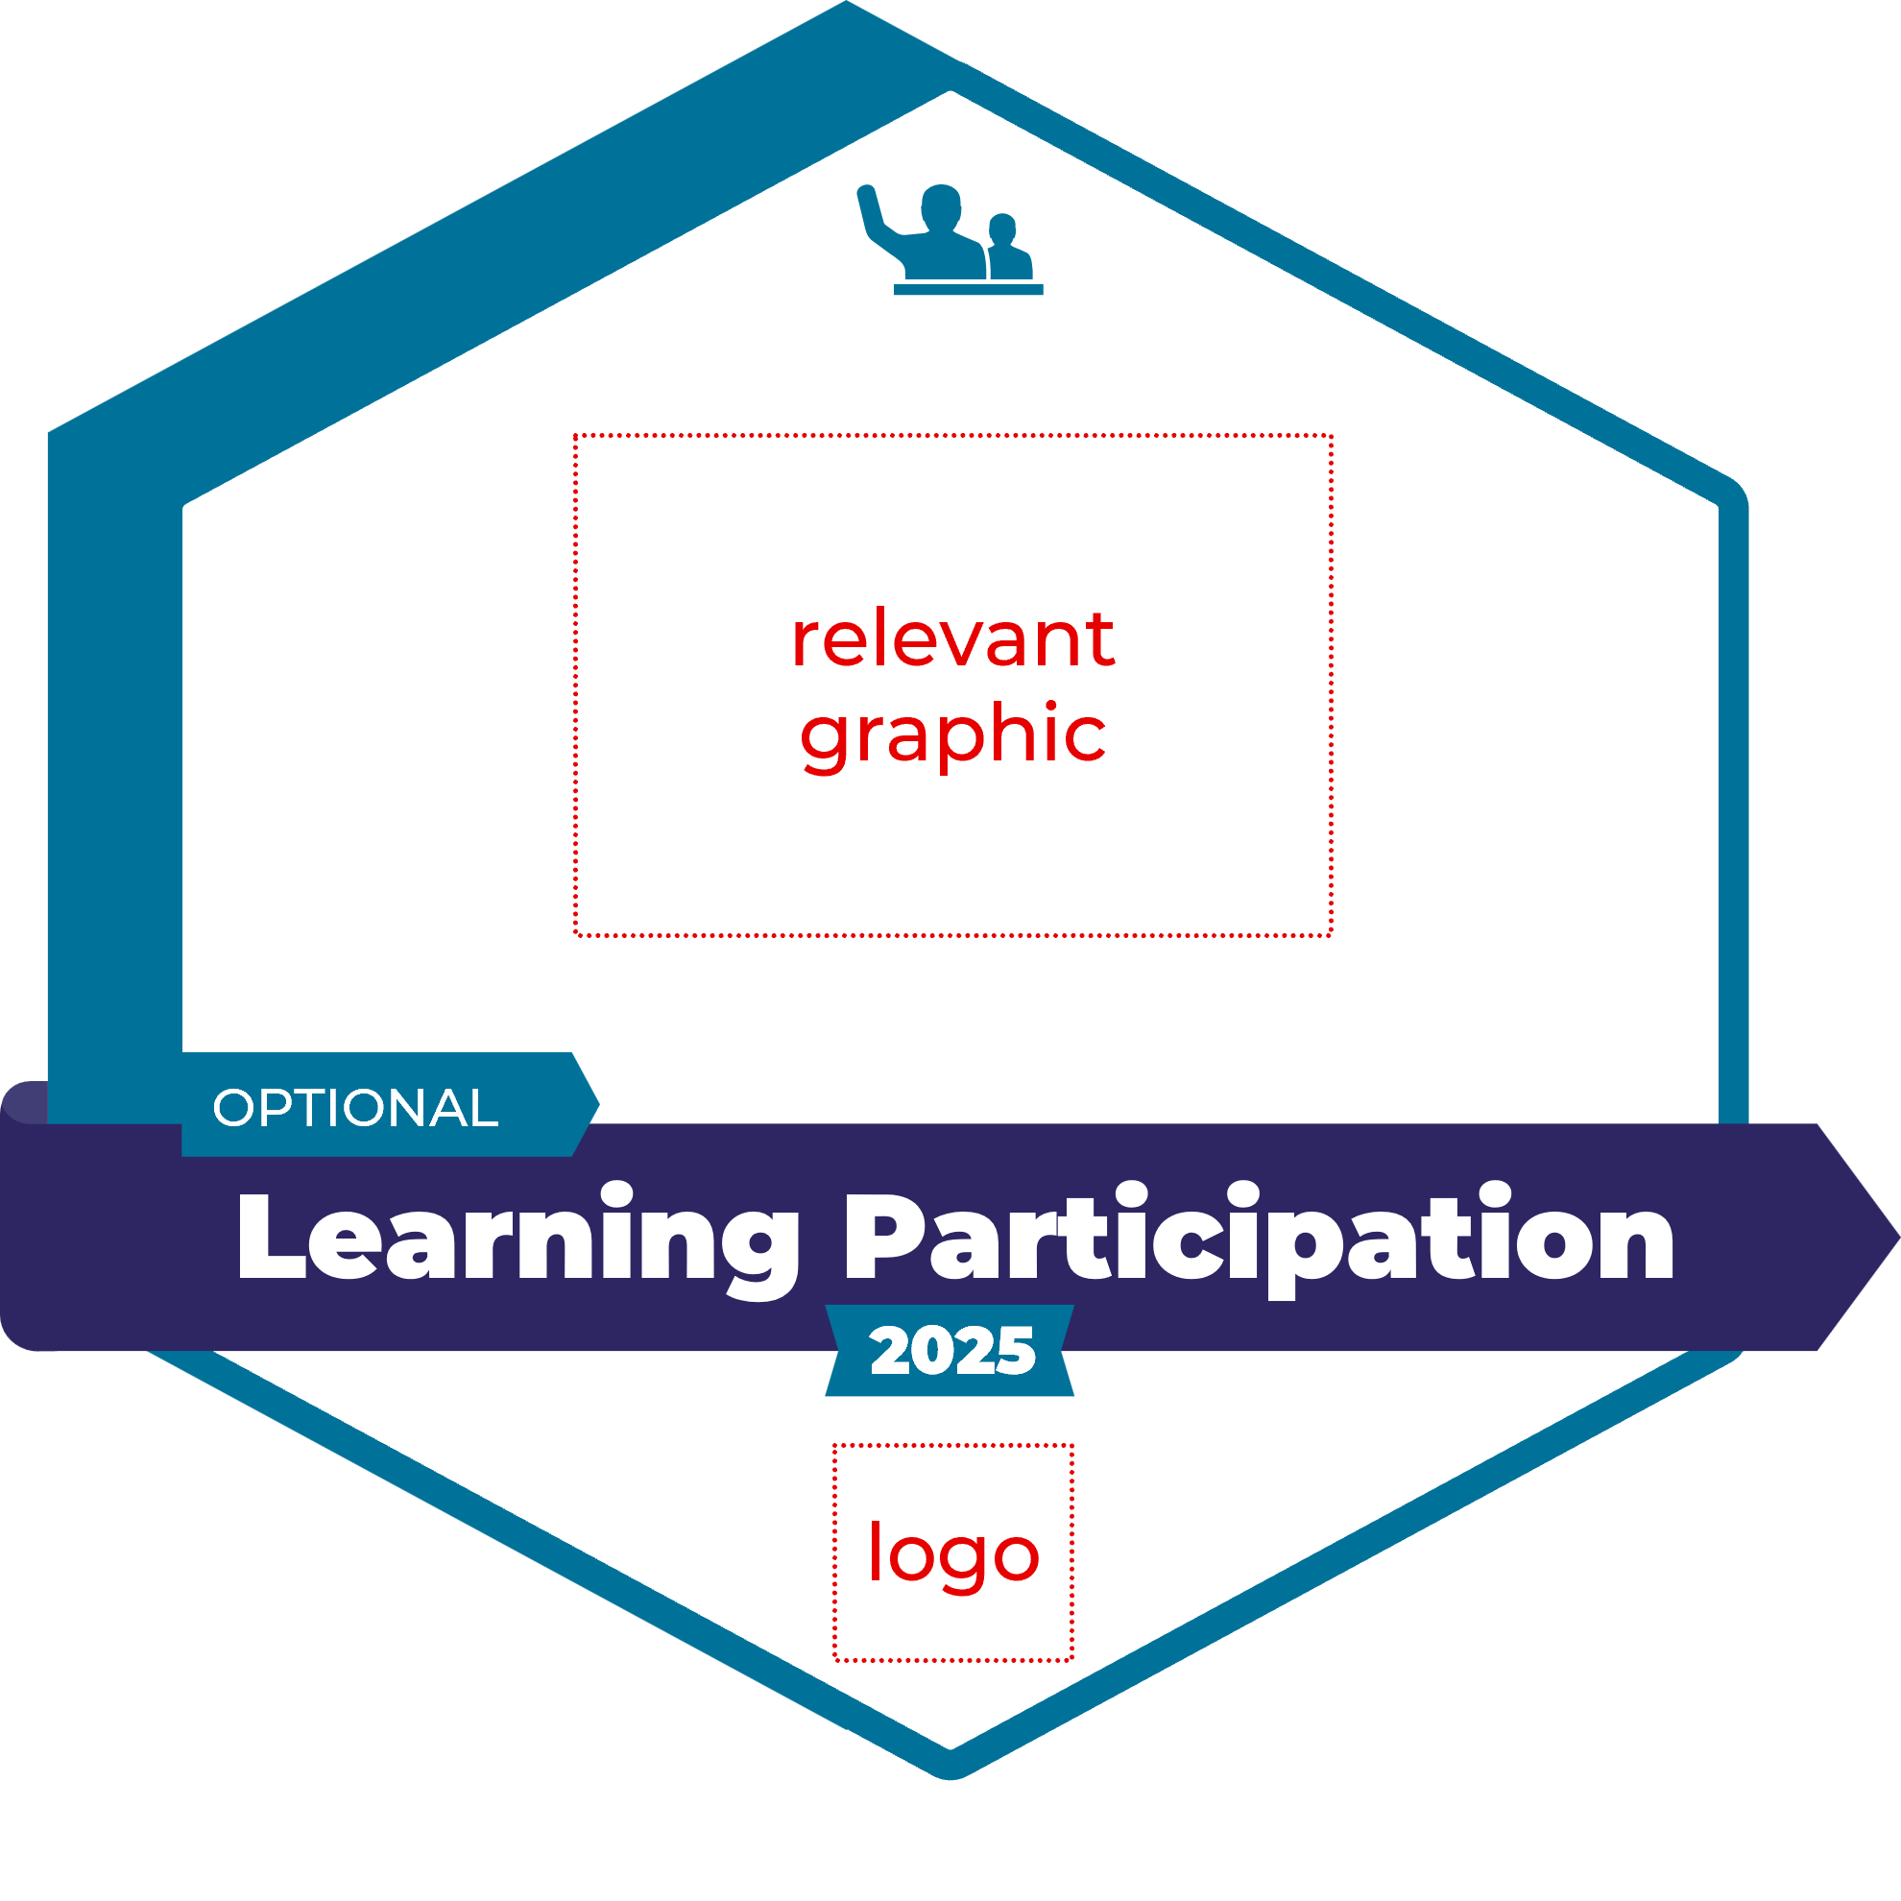
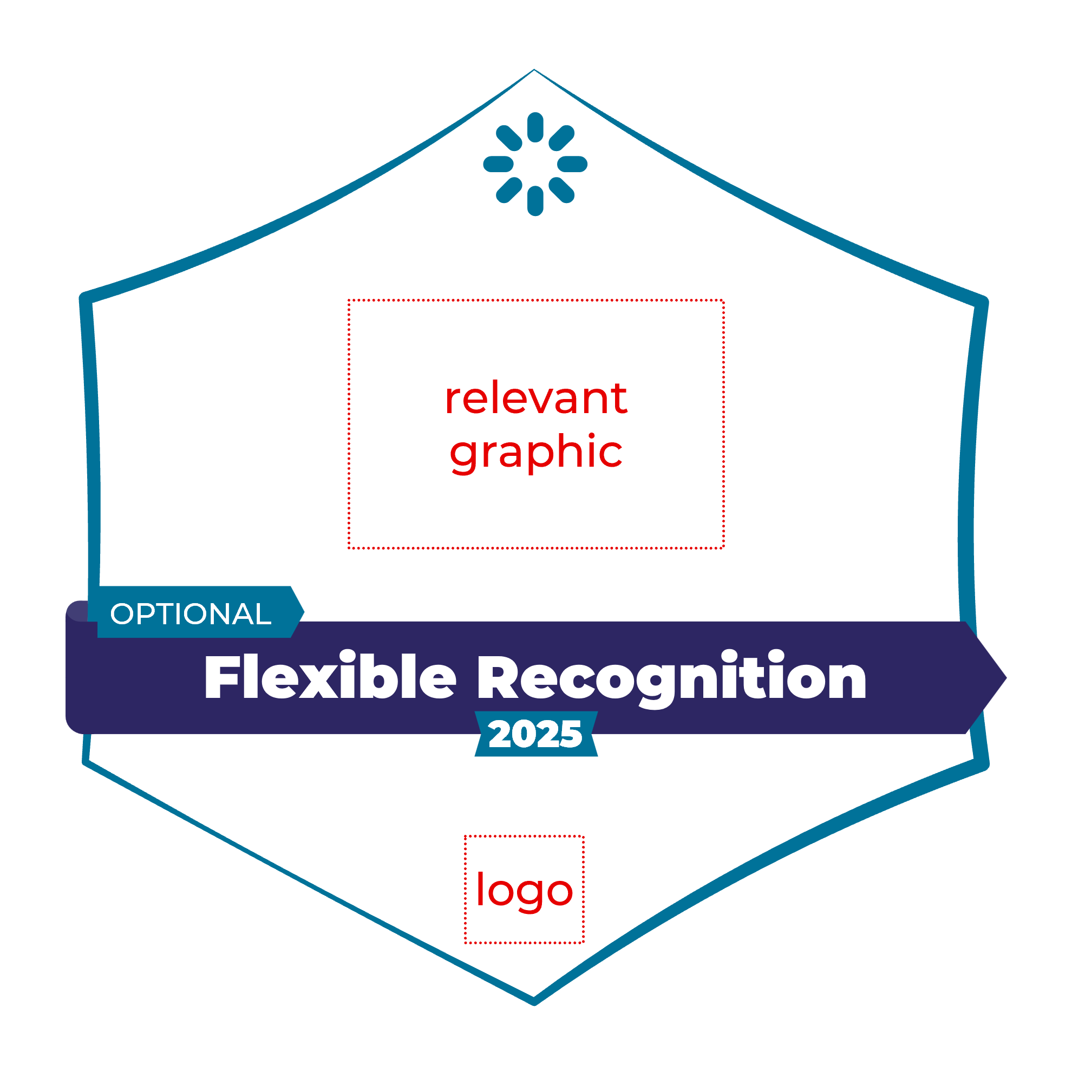
Learning Agents Flexible Recognition Framework – BADGE TYPES [REFERENCE]
FORMAL
INFORMAL
…robust summative assessment of the knowledge, skills, and/or competencies required for competent performance of an occupational or professional role or specific work-related tasks and responsibilities.
…summative assessment of courses or programs that evaluates successful achievement of the intended learning outcomes of the course or program. Often classified as a micro-credential.
…direct evidence or demonstrated performance. May be awarded based on assessment, which can range from rigorous to "appreciative". May also be self-asserted, perhaps endorsable by others.
…application of learning, active contribution to a project or initiative, performance and experience sustained over time, or a planned Work-Based Learning strategy. May be assessed, validated, witnessed or self-asserted , perhaps endorsable by others.
…completion of a course (often self-paced). May include formative assessment, discussion, application and/or opportunities for reflection, but lacking a rigorous summative assessment. Not normally classified as a micro-credential.
Organized learning, not assessed
…participation in a group webinar or workshop. May include formative assessment, discussion, application and/or opportunities for reflection, but lacking a rigorous summative assessment. Not normally classified as a micro-credential.
…adaptive container for recognizing a wide variety of achievements such as (not an exhaustive list):
Volunteering | Membership| Years of service | Awards for Excellence | Expertise ("Guru“) | Ad hoc callouts | Makerspaces
Advisory, non-prescriptive, adaptable. Based on observed practice. Learn more at learningagents.ca/recognition-framework
Learning Agents 2026-02-21
Notes:
Giving people badge templates as a flexible starting point helps them get over their badge creator block and helps the quality of the badge system…
→ But flexible, like how we’ve split organized learning into Completion and Participation here.
So there are 7 types here, but here could be 5. Or 3 or 9. It’s the consistency and the transparency that are important. Maybe you already have a badge taxonomy – if not, you can use ours.

Slide 8
Recognition Canvas | Additional Badges (optional)
For multiple badges in a badge system
Badge image
Badge image
Badge image
Description Required
Tweet length: the “recognition mission” of the badge
Description Required
Tweet length: the “recognition mission” of the badge
Description Required
Tweet length: the “recognition mission” of the badge
Criteria
Required
How does someone earn this badge? What learning activities? What assessment? How much effort? Be as clear and transparent as possible.
Criteria
Required
How does someone earn this badge? What learning activities? What assessment? How much effort? Be as clear and transparent as possible.
Criteria
Required
How does someone earn this badge? What learning activities? What assessment? How much effort? Be as clear and transparent as possible.
Learning Agents 2026-02-21

Slide 9
Potential Pathways View [REFERENCE]
Copy and remix as needed. Be creative!
(Based on Open Badge Factory/CanCred platform affordances. Use others as appropriate!)
Cluster
Sequence, Pathway
“Step”
Badge Name
“Step”
Badge Name
Milestone
Badge Name
“Step”
Badge Name
“Step”
Badge Name
“Step”
Badge Name
“Step”
Badge Name
Milestone
Badge Name
“Step”
Badge Name
“Step”
Badge Name
Sequential Program
Some step options
“Step”
Badge Name
“Step”
Badge Name
“Step”
Badge Name
“Step”
Badge Name
Milestone
Badge Name
Course
Certificate
Assignment,
Deliverable
Application
of learning
Super
Milestone
Badge Name
Nested Milestones
Independent
Assessment
Electives (e.g. 2 of 4)
“Step”
Badge Name
“Step”
Badge Name
Milestone
Badge Name
Placement,
Internship
Notable
Achievement
“Step”
Badge Name
“Step”
Badge Name
Certification
Learning Agents 2026-02-21

Slide 10
























































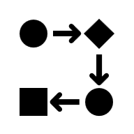















Elements for Badge Image Gallery (copy chosen elements to next page)
SHAPES – ADJUST SIZE, COLOUR/SHADING, BORDERS, COMBINE, ETC. (Must be square or on square transparent background)
ICONS – ADJUST SIZE, COLOUR, TRANSPARENCY, COMBINE, ETC. (Find more in e.g. Microsoft Office & Noun Project)
ICONS USED IN LEARNING AGENTS FLEXIBLE RECOGNITION FRAMEWORK
CERTIFICATION
WORKED EXAMPLE
(See Badge Image Gallery slide to make your own)
LEVELS
ASSESSED LEARNING
Transparent
BG
BANNERS
EVIDENCE OR DEMONSTRATION
Badge Name
APPLICATION AND PERFORMANCE
Opaque FG
Badge Name
LEARNING COMPLETION
Badge Name
Global Awareness Micro-credential
Badge Name
LEARNING PARTICIPATION
OUR
LOGO
Badge Name
FLEXIBLE RECOGNITION

Slide 11
Badge Image Gallery
HOW TO EXPORT:
Make BG 100% transparent
Group image elements (NB: lock aspect ratio!)
Save as Picture (PNG) for print/PPT version (6” ~ 2000 x 2000); then resize to 500 x 500 using image editing program for smaller upload version
OR: For smaller upload version (c. 500x500) resize badge to 1.5” as below, refit text & borders (÷4), then Save as Picture (PNG)
6 inches
Global Awareness Micro-credential
OUR
LOGO
1.5 inches
Global Awareness Micro-credential
6 inches
OUR
LOGO
1.5 inches

Slide 12
don@learningagents.ca
bit.ly/DonPresantPortfolio

